Slide 1

Resume Builder

Slide 2
Problem Statement
Creating a Resume template web application that allows users to edit and save their data.

Slide 3



Team Members:
Uppala Jayasree
Software Engineer
Thalla Saivivek
Software Engineer

Slide 4
Table of Contents:
Technologies Used
First Page Content
Initial Layout
Second Page Content
Final Layout
Code

Slide 5
Technologies Used
HTML
CSS
JavaScript
PHP

Slide 6
First Page Content
The first part of the code represents the content that is displayed on the initial page of the resume generator.
1.HTML Structure: The code begins with the standard HTML structure, including a ‘<head>’ section for including external styles and a ‘<body>’ section of the main content.
2. Conditional Display: The code checks if the server request method is POST or not. If it is POST, it means that the user has submitted that form with resume data. If not, it displays the form to input resume data.
3.Form Inputs: Inside the form, various input fields are provided for the user to enter their resume information, such as name, email, phone number, skills, education, experience and projects.

Slide 7
4.Profile Picture: A profile picture input field allows the user to select an image for their profile picture. An ‘<img>’ element displays a preview of the selected image.
5.Skills, Education, Experience, and Projects Inputs: Multiple Input fields are provided for skills, education, experience, and projects. These fields are initially set to read-only.
6.Add Project Button: A “Add Project” is provided for the user to add multiple project sections.
7.JavaScript Functions: JS functions are included to handle the image selection and toggle between read-only and edit modes for their input fields.
8.Submit Button: A submit Button is provided to generate the resume based on the entered data.

Slide 8
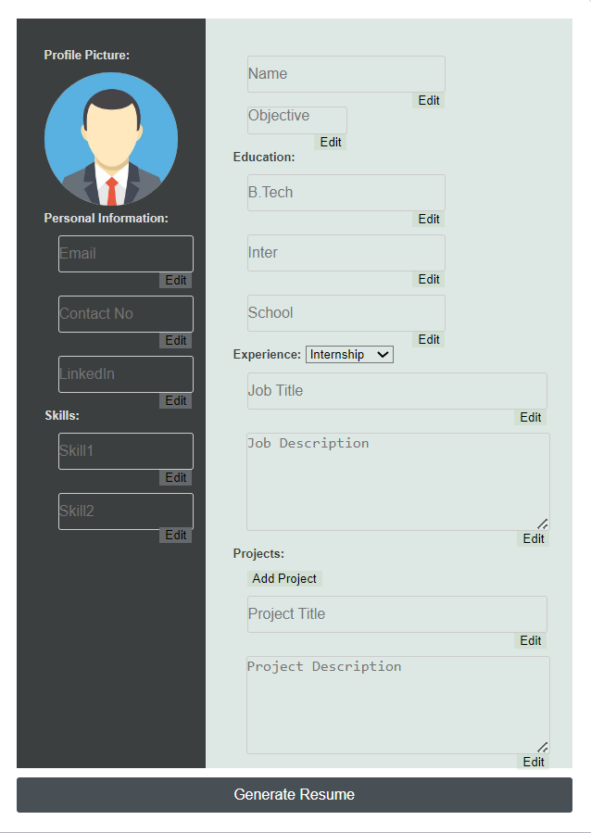
Initial Layout

Slide 9
Second Page Content
The second part of the code represents the content that is displayed when the user submits the form.
1.PHP Data Retrieval: The code starts with PHP logic that retrieves the submitted form data using the ‘$_ POST’ super global. This data is assigned to variables for further usage.
2.Form Structure: The code then restructures the form to display the entered data in a read-only format.
3.Displaying the entered Data: Each input field in the form is populated with the user’s entered data, making the form act as a preview of the resume. The entered data is displayed using the PHP variables that were populated earlier.

Slide 10
4.Displaying Projects: If the user has added the projects, these are displayed using a loop that iterates over the project data and populates the corresponding input fields.
5.Submit Button: The “Generate Resume” button is retained for the user to submit the form and generate the final resume.
6.JavaScript Functions: The JS functions provided in the first page content are included to handle image selection and toggling between read-only and edit modes input fields.

Slide 11
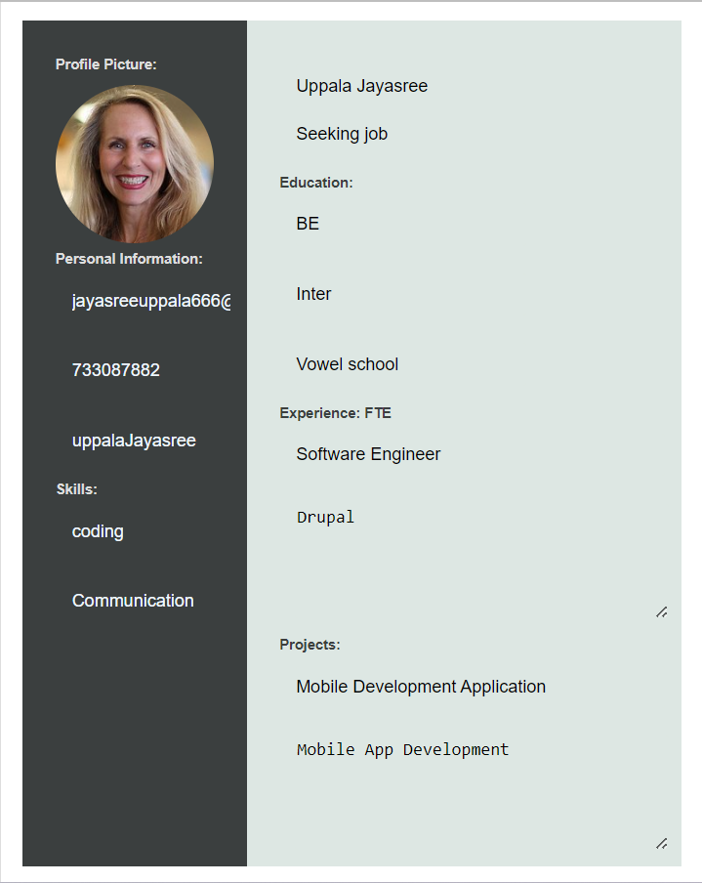
Final Layout

Slide 12
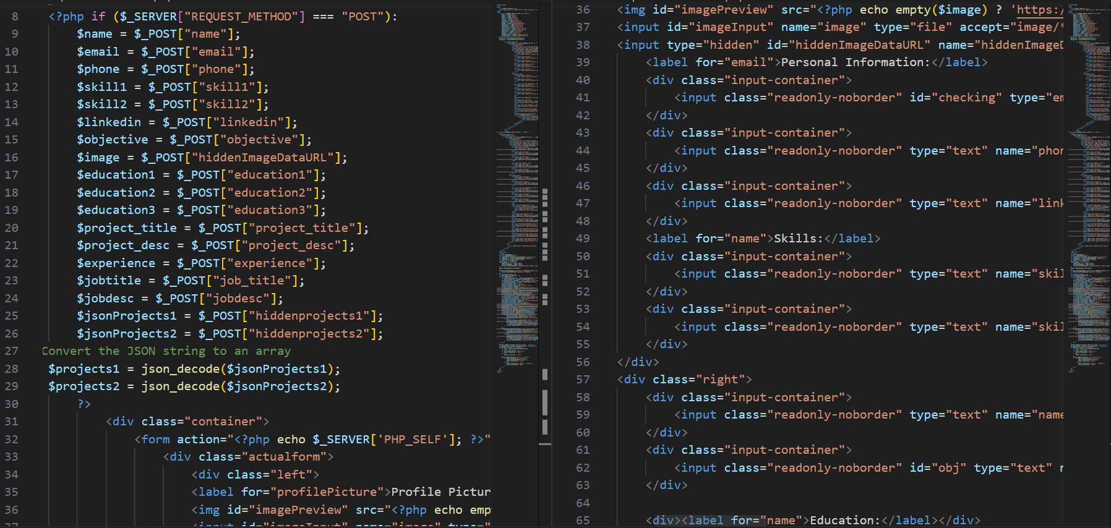
Code:
Here the code checks if the HTTP request method is POST:
-> form has been submitted,
->if it is, it retrieves the data from the POST request using PHP super global ‘$_POST’.

Slide 13
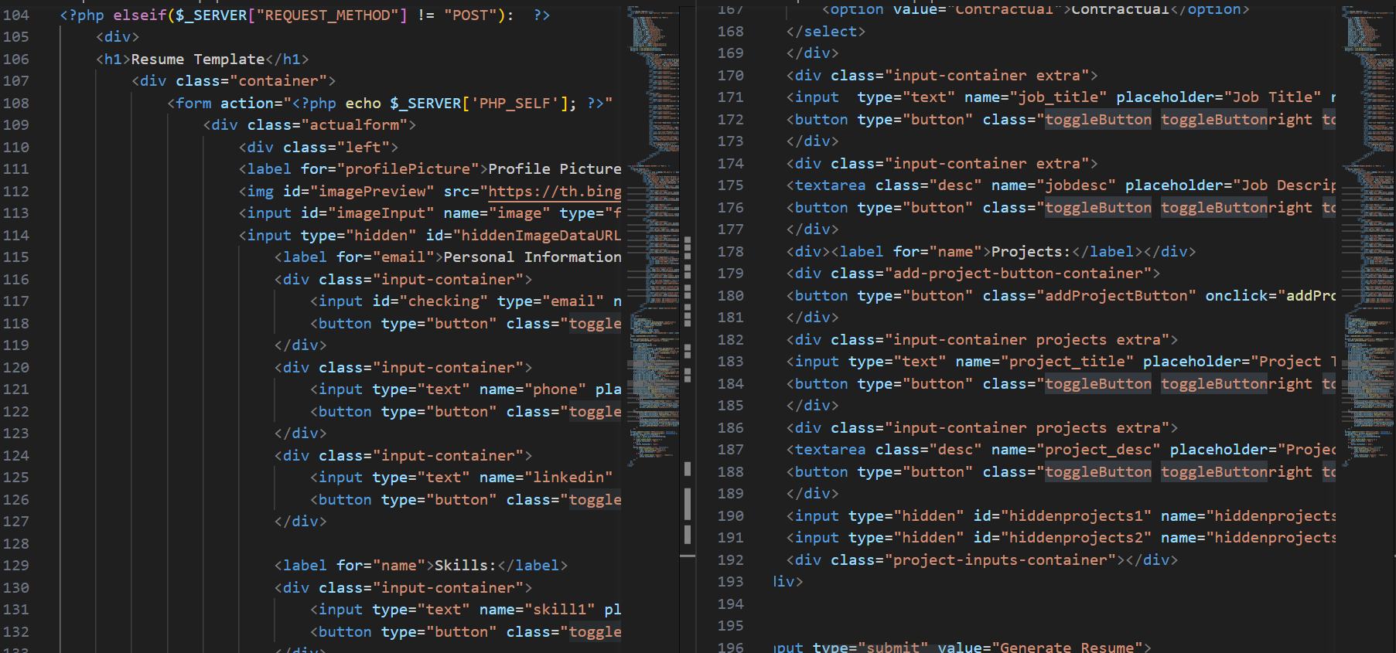
If the Request method is not POST that is the page is loaded initially or after a successful form submission an HTML is displayed to collect user input.

Slide 14
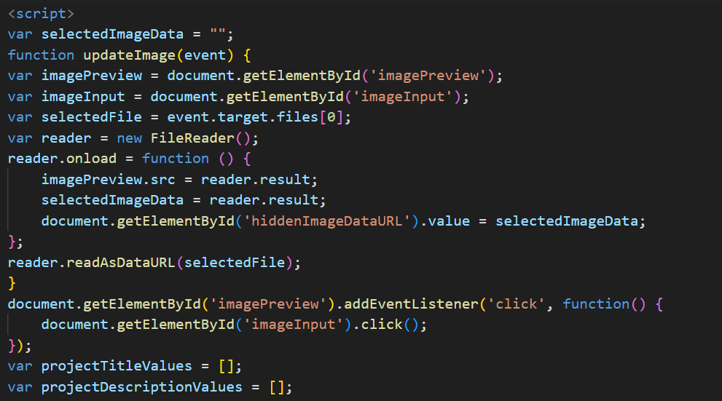
updateImage(event):
This function is called when the user selects an image file for the profile picture.
It displays the selected image in the image preview area and stores the data URL in a hidden input field.

Slide 15
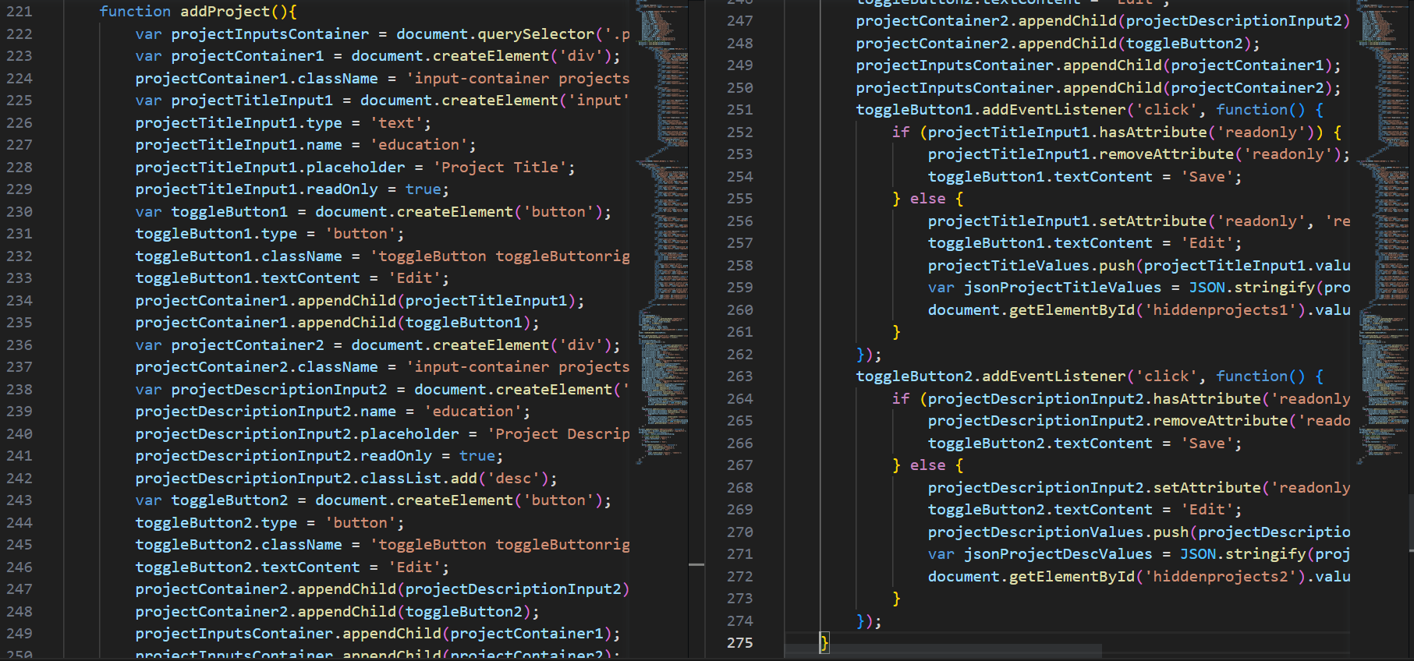
addProject():
This function adds additional project input fields when the user clicks the “Add Project” button.
It creates input fields for project titles and descriptions and attaches event listeners to the “Edit” buttons associated with each input.

Slide 16
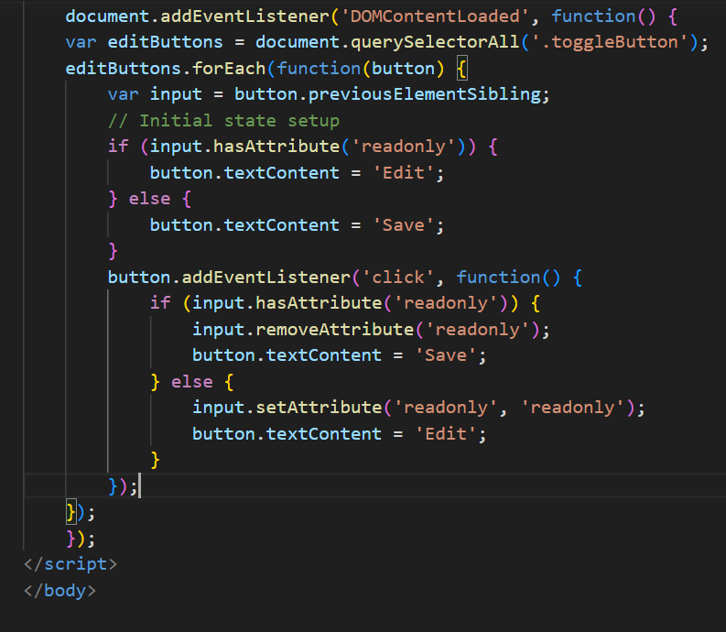
DOMContentLoaded:
This event listener executes JS code when the DOM is fully loaded.
It attaches event listeners to the “Edit” buttons for toggling between edit and save modes.

Slide 17



